Slide 1


VISVESVARAYA TECHNOLOGICAL UNIVERSITY BANGALORE COLLEGE OF ENGINEERING AND TECHNOLOGY
AN INTERNSHIP REPORT
ON
21INT49 - INTERNSHIP/PROFESSIONAL PRACTICE
Presented By:
HARSHITA M. JAIN (1BC21AI005)
Department of Artificial Intelligence and Machine Learning
Name of the faculty:
N. KASILINGAM (ME in CSE)
Head of the Department
Artificial Intelligence and Machine Learning

Slide 2
OBJECTIVE
The main objective of this internship is to enhance our skill and knowledge in the current working industries.
Based on this objective, we learnt the major scripting language, Python and Data Machine Learning With Python using Pandas, Matplotlib, Seaborn, ML Algorithms and some other python libraries.
The course is supplemented with many hands-on labs, Understanding the design and development of the IoT and analysing the complete EDA (Exploratory Data Analysis) of the given datasets.

Slide 3


ABOUT THE COMPANY
National Instruments Innovation Center, center of excellence was established in 2015 under the department of electronic and communication Engineering in collaboration with National Instruments Pvt. Ltd the world’s largest company dedicated to virtual instrumentation technology.
This center has complete NI platform of both software and hardware as LabVIEW-2015 (Full Development System, Professional Development System, Vision Development Module, etc.), Multisim, NI MyRIO, NI MyDAQ, Wireless Sensor Network, ELVIS Board, NI Smart Camera, Robotic starter kit Mechatronics kits etc.

Slide 4
DURATION
The duration of the internship was for 6 weeks, from 23rd September 2022 to 18th November 2022.

Slide 5
ABOUT THE PROJECT
The project was based on the analyzing the given data with the help of python libraries such as Pandas, NumPy, Matplotlib etc.
By using the following steps, we have analyzed and done the complete EDA (Exploratory Data Analysis) of the given datasets:
1. Titanic (with Target column 'Survived')
2. BigMart (with Target column ‘Item outlet sales')
The aim of this project is to represent statistics of the attrition trends and its causes by the help of graphs and charts.

Slide 6
Steps followed to analyze the datasets:
Data Collection: Data can come from different databases, web servers, log files, social media, excel and CSV files, etc.
Data Preparation: It involves cleaning the data to remove unwanted and redundant values, converting it into the right format, and making it ready for analysis.
Data Exploration: After the data is ready, data exploration is done using various data visualization techniques to find unseen trends from the data.
Result interpretation: The final step is to derive meaningful results and check if the output is in line with your expected results.

Slide 7
The Problem Statement 1- TITANIC:
On April 15, 1912, during her maiden voyage, the Titanic sank after colliding with an iceberg, killing 1502 out of 2224 passengers and crew. Translated 32% survival rate.
The Problem Statement 2- BIGMART:
The data scientists at BigMart have collected sales data for 1559 products across 10 stores in different cities for the year 2013.
The aim of the project is to build a predictive model to find out the sales of each product at a particular store so that it would help the decision makers at BigMart to find out the properties of any product or store, which play a key role in increasing the overall sales.

Slide 8
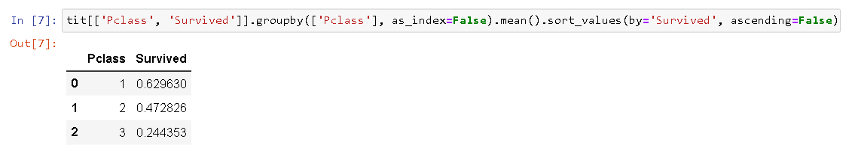
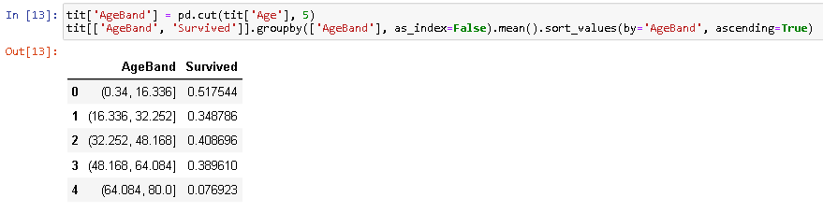
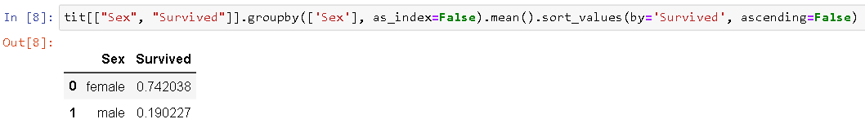
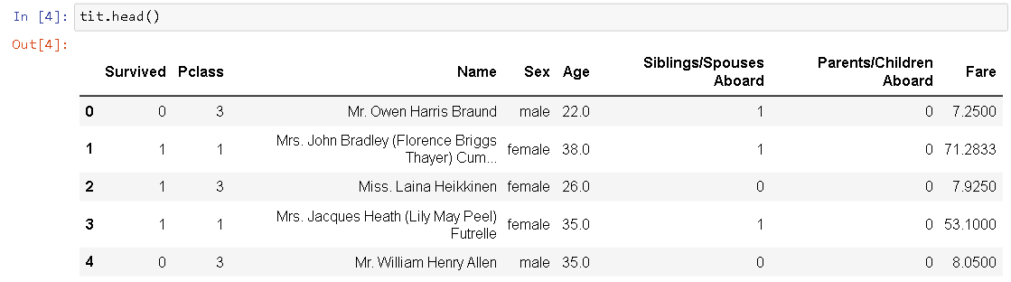
SNAPSHOTS OF TITANIC

Slide 9
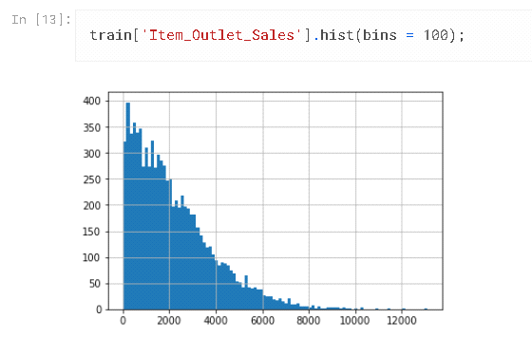
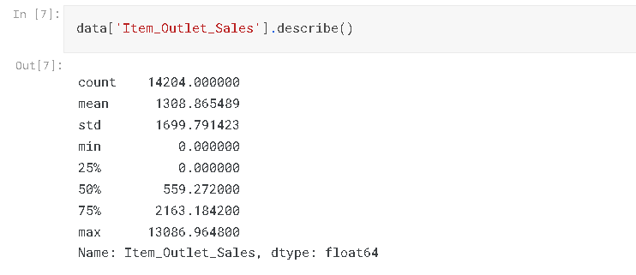
SNAPSHOTS OF BIGMART

Slide 10
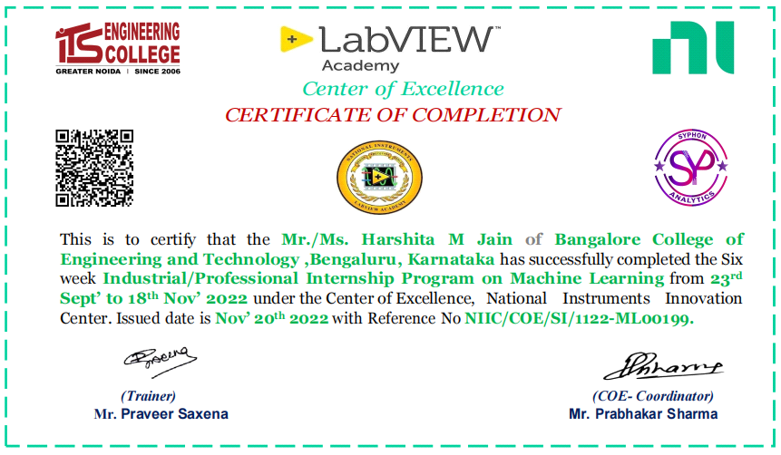
CERTIFICATE

Slide 11
REFERENCE
https://www.kaggle.com/code/startupsci/titanic-data-science-solutions
https://www.kaggle.com/code/pranavuikey/bigmart-eda-with-complete-explanation

Slide 12
ANY QUERIES ?
THANK YOU

